Slide 1
Web User Tracking
Prestented By
Dewanshu-007
Mohit malik-015
Pankaj-019
Sahil-023
Sumit-031

Slide 2
What is web user tracking?
Refers to the practice of tracking users across web sites in order to learn user interests and preferences
Benefits
Advertisers targets a more focused audience which increases the effectively
Consumer is “bothered” by more relevant and interesting ads

Slide 3
What is tracked?
IP address – general vicinity of your location
Time you accessed the page / email
Computer type and operating system
The browser you used
searches users make
websites visited
interactions on social network
Any previous information stored in cookies
Notes:
searches users make
websites visited
web content viewed
email content
watched videos
interactions on social network
online transaction
personal information

Slide 4
Online advertising
Banner ads (Doubleclick)
Standardized ad shapes with images
Normally not related to content
Context linked ads (Google AdSense)
Related to content on page
Search linked ads (Google Adwords)
Related to search terms

Slide 5
Why Do They Track
Website tracking for statistics, functionality, performance etc.
Website tracking for commerce
User tracking for profiling and targeted marketing

Slide 6
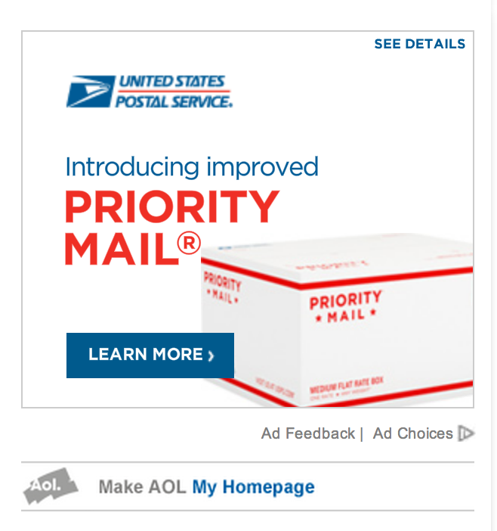
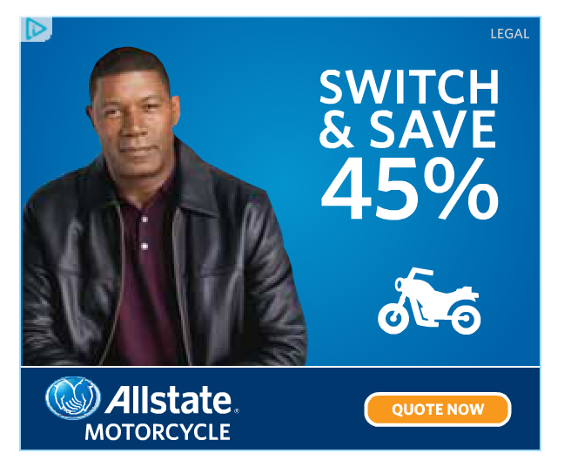
An Online Advertising Example: Adchoice
Visit website that have banner hosted for Adchoice including
Yahoo.com
msn.com

Slide 7
Online Tracking
Track user behavior as they move from site to site
Ways of tracking
Cookies
Browser Cookies
Flash Cookies
Beacons
Canvas Finger printing
Cross-Device identification

Slide 8

Browser Cookies
What is a cookie?
Browsers have allowed websites to store small amounts of information on the computer: Number of visits, Preferences, Login
Record your browsing activities
Pages and content you looked at
When you visited
What you searched
You clicked on an ad

Slide 9
Third party cookies (tracking across multiple sites)
Trackers, often advertising networks, use websites to install their cookies in users machine, known as third party cookies.
The third-party cookies can track users across multiple sites and tracking networks where its advertising banners or web beacons are placed
Condition: websites allow the tracker to collect data about their visitors.
Notes:
Pages visited by a user allows the advertising company to target advertisements to user’s presumed preferences
The advertising networks use the information collected by the third party cookie to create the profile of the user, which is also known as cookie profiling. The created profile is segmented as sports enthusiast, fashion enthusiast, parent, gamer, etc., and sold to the advertisers for ad targeting. The advertisers also pay the advertising networks to purchase the space and to place their ads on the websites. These third party services have tremendous value as they support free content and facilitate web innovation.

Slide 10
Flash Cookies, a Supper Cookie
Tougher version of tracking cookie, harder to locate and delete
It can be set through Adobe Flash via an embedded object in Flash, browser independent
The website running Adobe Flash can place these cookies on user’s hard drive, which is outside of browser’s control.
It can store user’s information up to 100 kilobytes whereas HTTP cookie can hold info up to 4 kilobytes.

Slide 11
Flash Cookies, a Supper Cookie
Flash cookies’ location on the user machine depends on the operating system.
In case of Windows it is:
[Root drive]:\Documents and Settings\[username]\Application Data\Macromedia\Flash Player\#SharedObjects\
Flash cookies are files with .SOL extension
For non-Windows, Macintosh OSX
/Users/[username]/Library/Preferences/Macromedia/Flash Player
Latest versions of Flash do not allow 3rd party sharing.

Slide 12
Web Beacons (tracking across multiple sites)
Also called web bugs and are used in combination with cookies to help people running websites to understand the behaviour of their customers.
A web beacon is typically a transparent graphic image (usually 1 pixel x 1 pixel) that is placed on a site or in an email.
To see the web beacon, we view the source of HTML page or email message

Slide 13
Web Beacons
<img src=“http://ad.doubleclick.net/ad/pixel.quicken/NEW” width=1 height=1 border=0
Single 1x1 image fetched from DoubleClick
Bugs alerts Doubleclick when any user views the website quicken.com
DoubleClick has systems for monitoring users who view DoubleClick advertisements
This web beacon allow companies to use DoubleClick monitoring system without the need to first show a banner advertisement

Slide 14
Uses of Web Bugs
According to Privacy Foundation, companies use web bugs to accomplish the following tasks:
Gather viewing and usage statistics for a particular page.
Correlate usage statistics between multiple web sites.
Profile users of a web site by gender, age, Zip code, and other demographics.
Transfer search strings from a search engine to a marketing company.

Slide 15
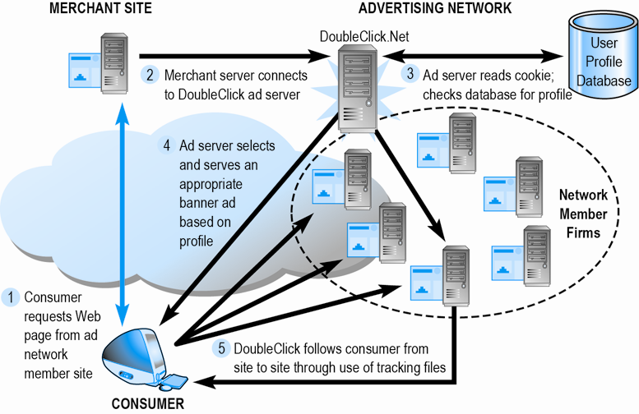
Web tracking example one: DoubleClick Tracking

Slide 16
Canvas Finger Printing
The HTML5 ‘canvas’ feature is exploited here, where the website visited by the user instructs the user's browser to draw a hidden line of text or 3D graphic which is then converted into digital token.
The data gathered can be used for profiling the user by the tracking ad networks which can be used for targeting the ads.

Slide 17
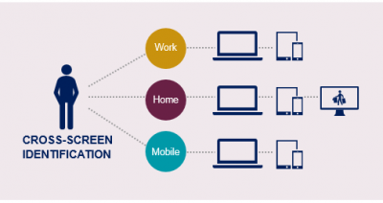
Cross-device identification (no cookie)
Cross-device identification primarily meant linking desktop computers, tablets and smartphones. With the advent, still nascent, of connected TVs, wearables and the Internet of Things, the concept of cross-device is expanding to potentially include anything that gives off a signal.
Notes:
http://blog.hartehanks.com/6-data-integration-techniques/

Slide 18



Opting Out
http://www.google.com/ads/preferences/
http://privacy.yahoo.com/aim
Companies including Yahoo, Microsoft, Google and AOL allow web surfers to opt out of tracking.
DoNotTrack:An HTTP header field “DNT” that requests a web application disables its tracking or cross-domain tracking. 1 (track), 0 (no track)

Slide 19

Defenses
Clearing all cookies: browser & flash
Blocking third party cookies (http://www.cnet.com/how-to/disable-third-party-cookies-in-ie-firefox-and-google-chrome/)
Private browsing allows you to browse the Internet without saving any information about which sites and pages you’ve visited.
Privacy Badger (was ShareMeNot): browser extension
Users can choose if they want to interact with social widgets, and if widgets can track users.
Notes:
Do Not Track is a technology and policy proposal that enables users to opt out of tracking by websites they do not visit, including analytics services, advertising networks, and social platforms.
ShareMeNot is a browser extension designed to prevent third-party buttons (such as Facebook's “Like” or Twitter's “tweet” button) embedded by sites across the Internet from tracking you until you actually click on them.
Private browsing
Firefox: https://support.mozilla.org/en-US/kb/private-browsing-use-firefox-without-history
iPhone, iPad: https://support.apple.com/en-us/HT203036
Chrome with incognito mode: https://support.google.com/chrome/answer/7005900?hl=en&rd=1

Slide 20
Thank You

